Slide 1

Kavya A
SCSE

Slide 2

Evolution of multi-core
Concurrency vs parallelism
Serial program vs parallel program
What is openMP
Writing a parallel program
Kavya A
SCSE

Slide 3

serial program : instructions in the program are executed one after the other in series, only one instruction is executed at a time.
Serial programs run on a single processor
Parallel Program : allows many instructions in a program to run simultaneously , in parallel
To achieve this, a program must be split into independent parts so that each processor can execute its part of the program simultaneously
Parallel computing can be achieved on a single computer with multiple processors, a number of individual computers connected by a network or a combination of the two.

Slide 4

MOORE’S LAW
“number of transistors incorporated in a chip would approximately double every 24 months”

Slide 5

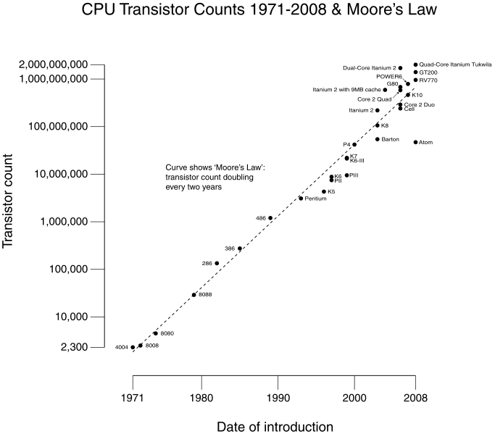

Slide 6

multi core
Single core
processor
processor
input
output
output
input
processor

Slide 7

Effective utilization of the hardware ?
There is no compiler that will automatically translate serial code to parallel code
On the part of programmer to design parallel code

Slide 8

Concurrency
  A condition of a system in which multiple tasks are logically active at one time.

Slide 9

parallelism
  A condition of a system in which multiple tasks are actually active at one time.

Slide 10

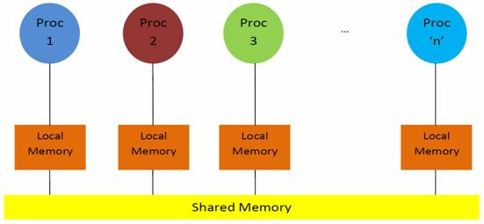

Slide 11

Process :
An instance of a program execution
The execution context of a running program.. i.e. the resources associated with a program’s execution
User address space
User address space
Stack pointer
Program counter
register
stack
text
data
heap

Slide 12

User address space
Thread’s are light weight process
Threads share process state among multiple threads
Stack pointer
Program counter
register
Thread 0 stack
Stack pointer
Program counter
register
Thread 1 stack
text
data
heap

Slide 13

Open mp is a multi threading programming language for shared address machines
An API for writing multi threaded applications
A set of compiler directives and library routines for designing parallel programs

Slide 14

#pragma omp construct [ clause]
Most of the openmp constructs are compiler directives

Slide 15

#include<stdio.h>
#include <omp.h>
main()
{
#pragma omp parallel
Printf(“Greeting”);
}

Slide 16

gcc -o omp_helloc -fopenmp omp_hello.c
Or
gcc -fopenmp omp_hello.c
./a.out

Slide 17

Int omp_get_num_threads();
return number of threads
Int omp_get_thread_num();
Return the thread id
Example
#pragma omp parallel
{
int n = omp_get_thread_num();
printf("Greetings from thread %d!\n", n);}

Slide 18
int omp_get_num_procs()
number of processors available
Int omp_get_max_threads()
maximum number of threads
omp_set_num_threads(int num_threads )
Set the threads

Slide 19

#include <stdio.h>
#include <omp.h>
int main( )
{ omp_set_num_threads(8);
printf("%d\n", omp_get_max_threads( )); #pragma omp parallel
{ printf("%d\n", omp_get_max_threads( ));
}
printf("%d\n", omp_get_max_threads( ));
}

Slide 20

#include <stdio.h>
#include <omp.h>
int main( )
{ omp_set_num_threads(8);
printf("%d\n", omp_get_num_threads( )); #pragma omp parallel
{ printf("%d\n", omp_get_num_threads( ));
}
printf("%d\n", omp_get_num_threads( ));
}

